Slide 1
MTA Data Analysis of NYC
for Cancer Awareness Association (CAA)
presented by : Abdullah Alsubaie

Slide 2
Introduction
1
(CAA) is holding an annual gala, and hopes to invite as many interested individuals as possible.
2
(CAA) is intending to place street teams at the entrance to NYC subway stations to collect email addresses and give out free tickets.
3
Agenda: Apply data analytics on the MTA subway data on traffic flow to optimize placement of street teams to maximize engagements.

Slide 3
Objectives
11
Assumption
find 10 locations for teams to go, which day of the week is better?
23
Assumption
the team would stay in the same place for the entire day ,they will not travel.
35
Assumption
Same station will have most likely have the same people everyday... no need to return to that station.

Slide 4
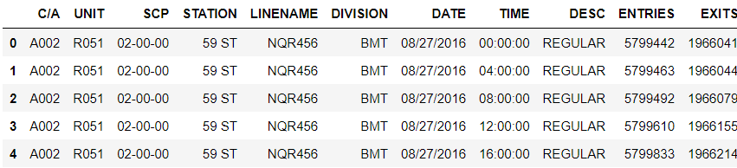
#
Methodology
Data analysis with the following (seaborn & pandas)
Wrote a script to webscape weekly MTA turnstile data to analyze traffic.

Slide 5
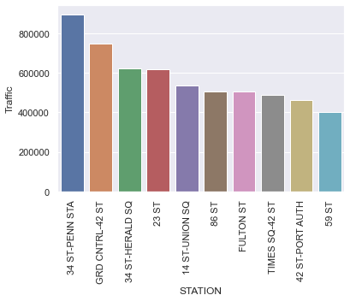
#
Results
Distribution of traffic across the top 10 stations.

Slide 6
#
Key Findings
34 ST-PENN STA
GRD CNTRL-42 ST
34 ST-HERALD SQ
23 ST
station has notably more traffic than the rest.

Slide 7
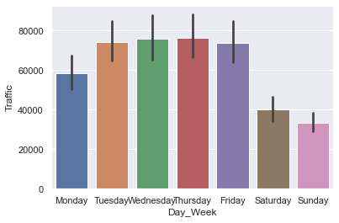
Distribution of traffic across the week
Trend shows that traffic on weekdays is generally more than weekends.

Slide 8
Conclusion
If time is a constraint, (CAA) should focus on weekdays in the period of late afternoons to late evenings.
Given limited manpower resources, (CAA) should focus on sending street teams to the top 10 busiest MTA stations.
Morning period on weekdays can be avoided due to has less traffic and commuters are busy reporting to work.

Slide 9
THANK YOU

